Slide 1


Mixture & Alligation-1 Session No.: 03 Course Name: Verbal & Quantitative Reasoning -1 Course Code: O1UA422L Instructor Name: Brajesh Kumar Duration: 100 min

Slide 2
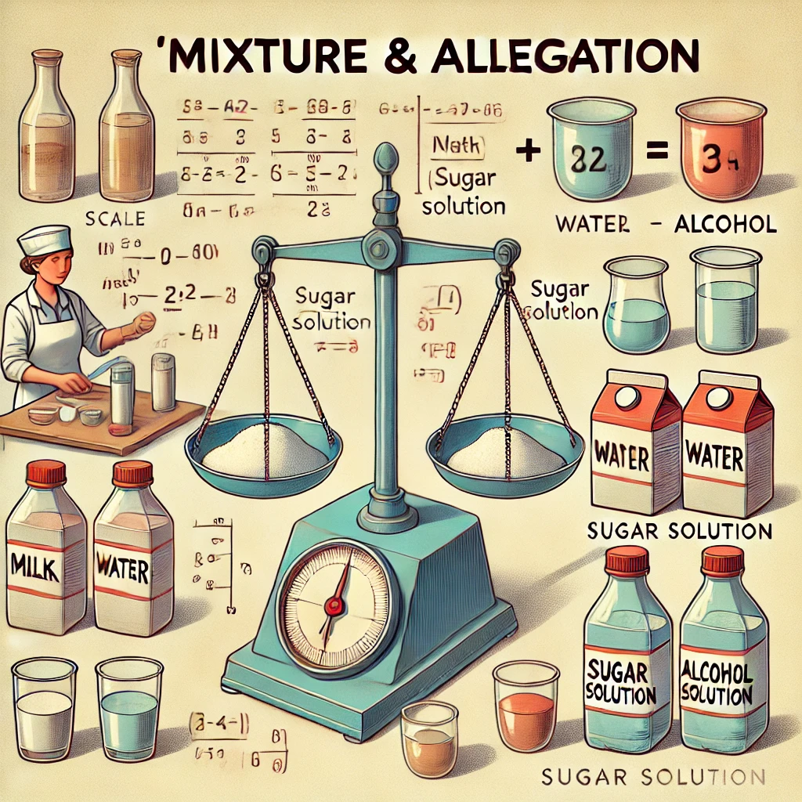

Slide 3
Aim To enhance students' understanding of Mixture & Alligation through interactive and innovative activities, fostering real-world applications and collaborative learning.

Slide 4
At the end of this session students will be able to
Learning Outcome 1: Identify when and why the rule of alligation is used.
Learning Outcome 2: Apply the rule of alligation to diverse real-life situations effectively.

Slide 5
Session Outline
1 Quick “Think Pair Share” on prior knowledge.
2 Brainstorm real life example
3 Group work
4 Solve & discuss word problem on Mixture and Alligation
5 Summarize key takeaways
6 Reinforce learning with quick recap

Slide 6

Learning Activity 1

Slide 7

Reflection- Learning Activity 1

Slide 8
Mixture: A combination of two or more items or substances (solids, liquids, or gases) in a particular ratio. Examples: alloys (bronze), lemonade, or mixing two types of rice etc. Alligation: A mathematical method based on weighted averages that quickly calculates the ratio of ingredients needed to obtain a mixture of a specific "Mean Price" or quality.

Slide 9
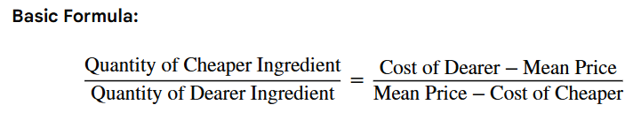
The Alligation Rule & Formula
The most common way to solve these problems is the "Criss-Cross" method. It states that the ratio of ingredients is inversely proportional to the differences in their prices.

Slide 10
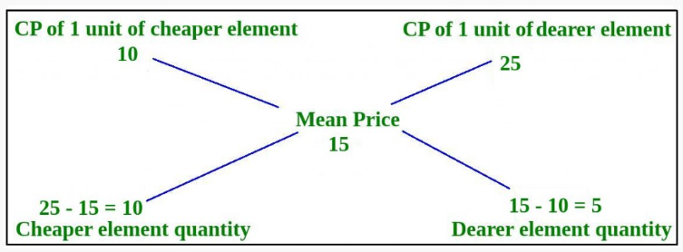

Slide 11
Q 1. Two varieties of tea are mixed in some ratio. The cost of the first variety is ₹20 per Kg and that of second variety is ₹30 per Kg. If the average cost of the resulting mixture is ₹25 per Kg, find the ratio.
1:2
b) 1:1
c) 2:3
d) 6:5
Notes:
B

Slide 12
Q2. A shopkeeper sells two types of sugar, one costing ₹45/kg and the other ₹60/kg. In what ratio should they be mixed to create a mixture worth ₹50/kg? (a) 2:1 (b) 2:3 (c) 3:2 (d) 4:5
Notes:
A

Slide 13
Q-3.Two varieties of rice are in the ratio of 3:2 such that the average price of the resulting mixture is ₹15 per Kg. The price of first of the varieties is ₹10 per Kg. Find the price of the second variety of rice.
30
b) 20
c) 22.5
d) 33
Notes:
C

Slide 14
Q-4. Calculate the average price of the resulting mixture when two variety of sugar at ₹12 per Kg and ₹15 per Kg are mixed in the ratio of 2:3.
a) 13.8
b) 12
c) 20
d) 22
Notes:
A

Slide 15
Q-5. In what ratio must two kinds of sugar at Rs. 1.15 and Rs. 1.24 per kg be mixed so that by selling at Rs. 1.50 per kg, 25% may be gained?
A) 4: 5
B) 5: 4
C) 1: 1
D) 2: 3
E) None of these
Notes:
A

Slide 16
Q-6. Two varieties of wheat are mixed in the ratio of 4:5. The price of the mixture is ₹15 per Kg. The price of the variety having lesser weight is ₹12 per Kg. Calculate the price of the other variety .
a) 17.4
b) 16
c) 30
d) 20
Notes:
A

Slide 17
Q-7. How many kg of Sugar at 50 P per kg must a man mix with 25 kg of sugar at 34P per kg so that by selling the mixture at 44P per kg he gains 10% on the outlay?
1. 10 kg
2. 15 kg
3. 20 kg
4. 16 kg
5. 18 kg
Notes:
B

Slide 18
Q 8. The milk to water ratio in two containers is 4:1 and 2:5 respectively. In what ratio should they be mixed to obtain a final mixture with a milk to water ratio of 1:1? (a) 3:2
(b) 4:3
(c) 5:7
(d) 7:5
Notes:
C

Slide 19
Q-9. A tank contains 80 litres of a 20% salt solution. How much pure water should be added to make it a 10% solution? (a) 40 litres
(b) 50 litres
(c) 60 litres
(d) 80 litres
Notes:
D

Slide 20
Q-10. A container has 50 litres of a milk-water solution in a 3:2 ratio. If 10 litres is removed and replaced with water, find the new ratio of milk to water. (a) 9:11
(b) 10:15
(c) 11:19
(d) 12:13
Notes:
D

Slide 21
Q-11. A milkman mixes 30L of water in 90L of milk. He then sells 1/4th of this mixture. Now he adds water to replenish the quantity of milk sold. Find the current proportion of milk and water.
a) 25:9
b) 9:7
c) 16:9
d) 16:7
Notes:
B
The instruction likely meant to replace the total quantity removed (30L) with water to return to 120L capacity, or replenish the volume sold (30L) with water. Let's assume it means returning the total volume to 120L.

Slide 22
Q-12. An alloy of copper and nickel contains 65 % copper. A second alloy contains copper and nickel in the ratio 17 : 3. In what ratio should the two alloys be mixed so that the new mixture contains 4 times as much copper as nickel?
1. 4 : 5
2. 5 : 4
3. 1 : 3
4. 2 : 3
5. None of these
Notes:
C

Slide 23
Q-13. Two jugs X and Y having coca cola and water mixed in the proportion 5: 2 and 7: 6 respectively. Now if we want a new mixture in jug Z having coca cola and water in the proportion of 8:5 then what will be the ratio?
a) 5:6
b) 3:4
c) 6:7
d) 7:9
Notes:
D

Slide 24
Q-14. A drum full of green tea contains 50% herbs. A part of tea is replaced by another tea containing 29% herbs and now the percentage of herbs is found to be 36%. What quantity of green tea is replaced ?
a) 1/3
b) 2/5
c) 2/3
d) 3/7
Notes:
C

Slide 25
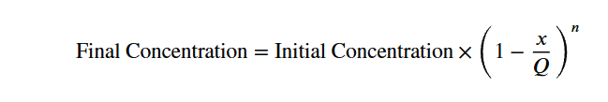
Formula for the replacement based questions
Q- Initial Total Quantity
X- Removed/Replaced Amount
n- Number of operations
Notes:
D

Slide 26
Q-15. A vessel comprises 80 litres of petrol. Out of this 8 litres of petrol was taken out and swapped by kerosene. This is done two more times. Now calculate the quantity of petrol in the vessel?
a) 25.22
b) 39.05
c) 46.21
d) 58.32
Notes:
D

Slide 27
Q-16. A vessel contains 100 litres of a 40% acid solution. 20 litres of this solution is removed and replaced with water. The operation is repeated twice. Find the final concentration of acid. (a) 25.6%
(b) 27.4%
(c) 29.2%
(d) 31.8%
Notes:
A
$$\text{Final} \text{Concentration}=40\%×{\left(1−\frac{20}{100}\right)}^{2}$$
Final Concentration=40%×1−201002
$$\text{Final} \text{Concentration}=40\%×{\left(\frac{4}{5}\right)}^{2}$$
Final Concentration=40%×452
$$\text{Final} \text{Concentration}=40\%×\frac{16}{25}=\frac{640}{25}\%=25.6\%$$
Final Concentration=40%×1625=64025%=25.6%

Slide 28
Q-17. A 90-liter mixture contains alcohol and water in a ratio of 5:4. 10 litres is removed and replaced with water twice. Find the new alcohol-to-water ratio. (a) 17:23
(b) 19:26
(c) 320:409
(d) 220:273
Notes:
C
$$\text{Final} \text{Quantity} \text{of} \text{Alcohol}=50×{\left(1−\frac{10}{90}\right)}^{2}$$
Final Quantity of Alcohol=50×1−10902
$$\text{Final} \text{Quantity} \text{of} \text{Alcohol}=50×{\left(\frac{8}{9}\right)}^{2}=50×\frac{64}{81}=\frac{3200}{81}$$
Final Quantity of Alcohol=50×892=50×6481=320081
Final Quantity of Water =
$$90−\frac{3200}{81}=\frac{7290−3200}{81}=\frac{4090}{81}$$
90−320081=7290−320081=409081
Final Alcohol:Water ratio =
$$\frac{3200}{81}∶\frac{4090}{81}$$
320081∶409081
= 3200:4090 = 320:409.

Slide 29
Q-18. A vessel contains 80 litres of a 50% sugar solution. If 40 litres of solution is removed and replaced with water three times, find the final concentration of sugar. (a) 12.5%
(b) 20.5%
(c) 5.5%
(d) 6.25%
Notes:
D

Slide 30
Q-19. Five litres of wine is removed from a cask full of wine and is replaced with water. Five litres of this mixture is then removed and replaced with water. If the ratio of wine to water in the cask is now 16 : 9, how much wine did the cask hold ?
1. 25 litres
2. 50 litres
3. 100 litres
4. 150 litres
5. 175 litres
Notes:
A

Slide 31
Q-20. 8 litres of diesel is replaced by oil from a vessel full of diesel. This process is done 2 more times. The ratio of the diesel: oil left in vessel is 8 : 19. How much diesel was there in the vessel first ?
a) 22 b) 24 c)26 d) 28
Notes:
B

Slide 32

Reflection- Learning Activity 2

Slide 33
Summary
Mixture and Alligation is a method used to find the ratio in which two or more substances of different values are mixed to obtain a mixture of a desired value.
It is commonly applied in problems involving prices, concentrations, and percentages to quickly determine mixing ratios.

Slide 34
Outcome 1: Identify when and why the rule of allegation is used.
Outcome 2: Apply the rule of allegation to diverse real-life situations effectively.

Slide 35

Review and Reflection from students

